Slide 1
Pragmatic and Discourse

Slide 2
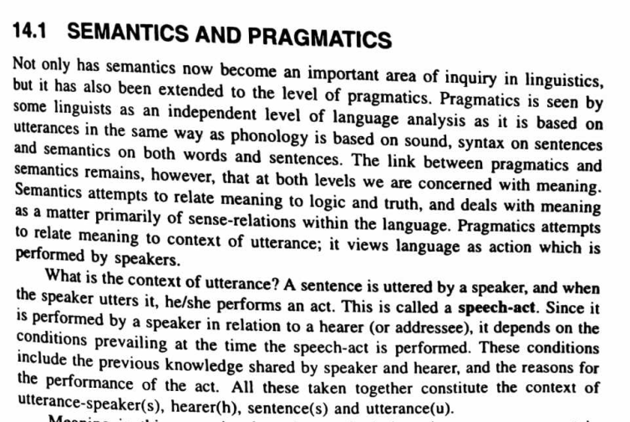

Slide 3
pragmatic
adjective
dealing with things sensibly and realistically in a way that is based on practical rather than theoretical considerations.

Slide 4
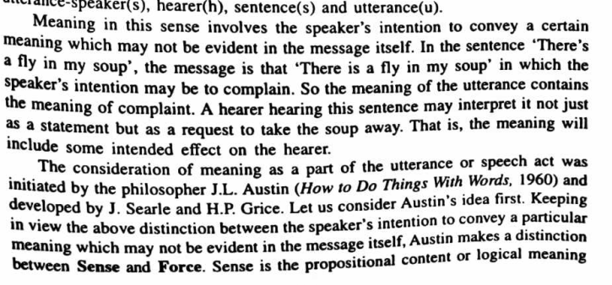

Slide 5
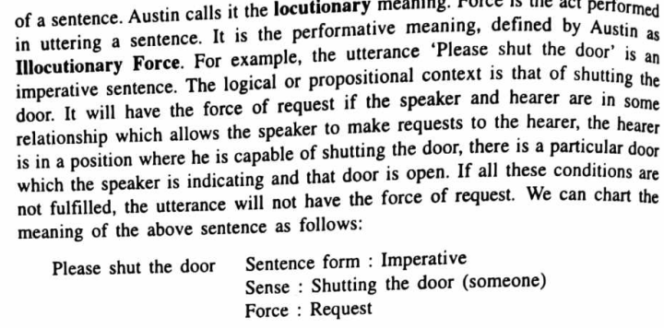

Slide 6
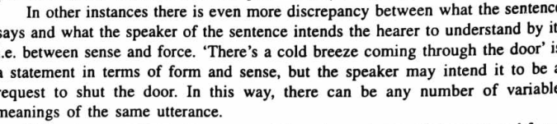

Slide 7
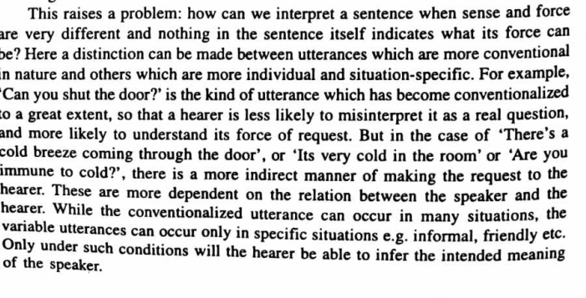

Slide 8
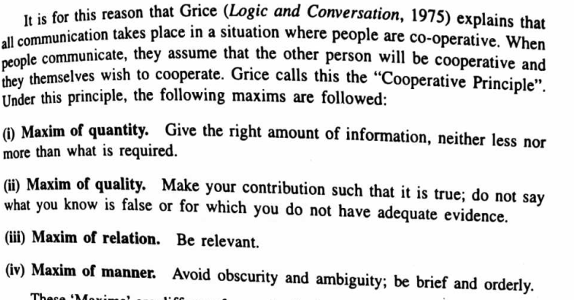

Slide 9
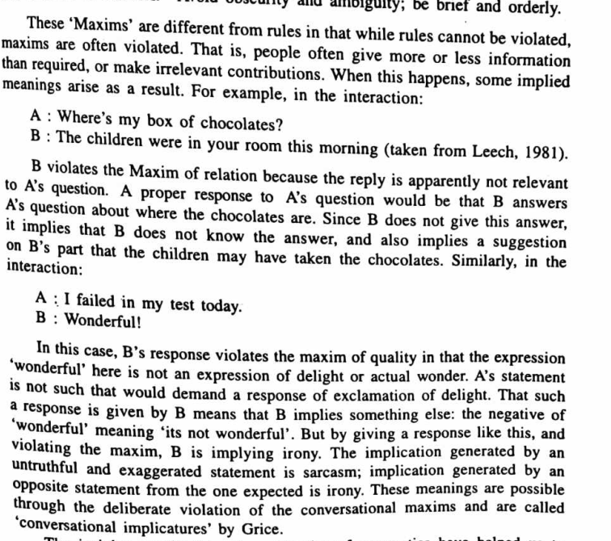

Slide 10
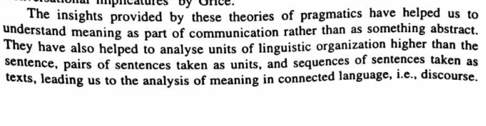

Slide 11
Discourse Analysis
Any unit of connected speech or writing that is longer than a sentence and that has a coherent meaning and a clear purpose is referred to as discourse. An example of discourse is when you discuss something with your friends in person or over a chat platform.

Slide 12
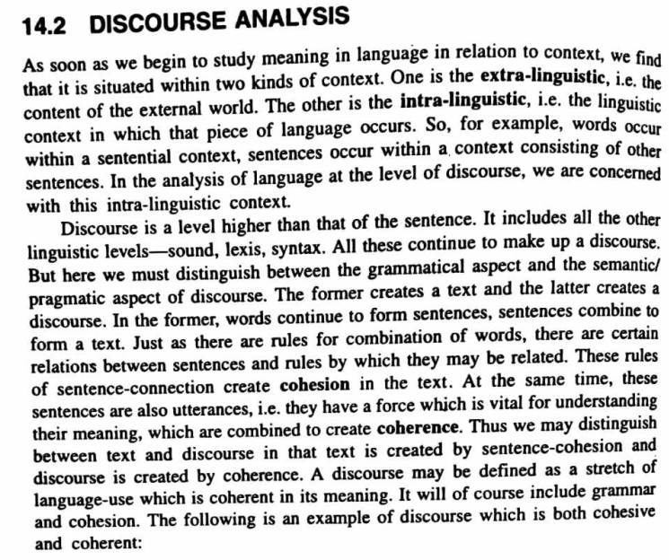

Slide 13
